Slide 1
Team GoPals –
December 28, 2022

Slide 2
About Team GoPals
Established on October 3, 2014
Vision: Spread Awareness and Application of Desi Cows (Native Cow Breeds)
Organization: GoPals Charitable Trust (Accreditations: 80G and Section 12A)
Network: 7 chapters in Bangalore, Mysore, Chennai, Hyderabad, Coimbatore, Tirunelveli, and Gulbarga
Volunteers: Farmers, Students, Government employees, and Private employees in the IT/BT sector

Slide 3
GoPals – Key Stakeholders
Natural Farmers
Native Cowsheds
Consumers
Encourage traditional Natural Farming (Native Cow – based farming)
Create self-sustainable business models for Native Cowsheds (Goshalas) to produce cow-based dairy and consumer products
Connect the Natural Farmers and Native Cowsheds to urban and rural consumers to help replace chemical-ridden products with natural healthy products

Slide 4
GoPals – Key Initiatives
Sponsor a Calf (SAC): INR 10 / Day / Person
Set up Borewells to create a water source for cows in Kodumudi (Tamil Nadu), Tirunelveli (Tamil Nadu), and Ravanasamudram (Tamil Nadu).
Constructed Water Tank in Shivalinga, Sedam, Karnataka
Supported farmers in several districts in Karnataka to set up Organic Input Centres to make Cow-based inputs to substitute Fertilizers, Insecticides, and Herbicides
Corporate Training
Conducted Employee workshops on Water Footprint and Food Intake Analysis
Outcome: Customized report for responsible food consumption and water usage

Slide 5
GoPals – Key Initiatives (Continued)
Events
Events conducted at native cow cowsheds (Goshala’s) with activities like cowshed cleaning, a selfie with the calf, bullock cart rides (for children) and knowledge sessions from eminent personalities
Vriksham – Agroforestry
30,000+ Saplings planted in cow habitats

Slide 6
Goals: What we set out for in 2022?
Organic Input Centers – Expand
Farmer Partners – Evaluate requirements and extend support
Sponsor a Calf (SAC) – Expand beneficiaries
Volunteer base – Expand
Corporate Connect – Enhance connect with corporates
Know Your Cow (KYC)
Sustain a Farmer (SAF)
Farmer to Consumer (F2C) – Explore options for online marketing
Breed Development and Conservation
Farmer Connect – Connect with more farmers and villages

Slide 7
Goal 1: Organic Input Centre
Organic Input Centres are low-cost - high value input preparation units in villages which produce inputs for Seed Treatment, Nutrient Supply (fertilizers), Insecticides, Fungicides, Viricides and Organic Herbicide which are essential to pursue natural farming
Team GoPals helped setup 5 Centres in Karnataka: Kalaburgi District (Agricultural College, Boganhalli, Mahagaon , Keriamvalaga), Koppal District (Chilakmuki)
Recent Updates
Fodder Cultivation and Fodder Bank setup in Kalaburgi District, Karnataka
5 acres land leased for fodder cultivation
“Weeds as food” introduced to reduce herbicide spray and animals get good feed
Training conducted on “Weeds as food”

Slide 8
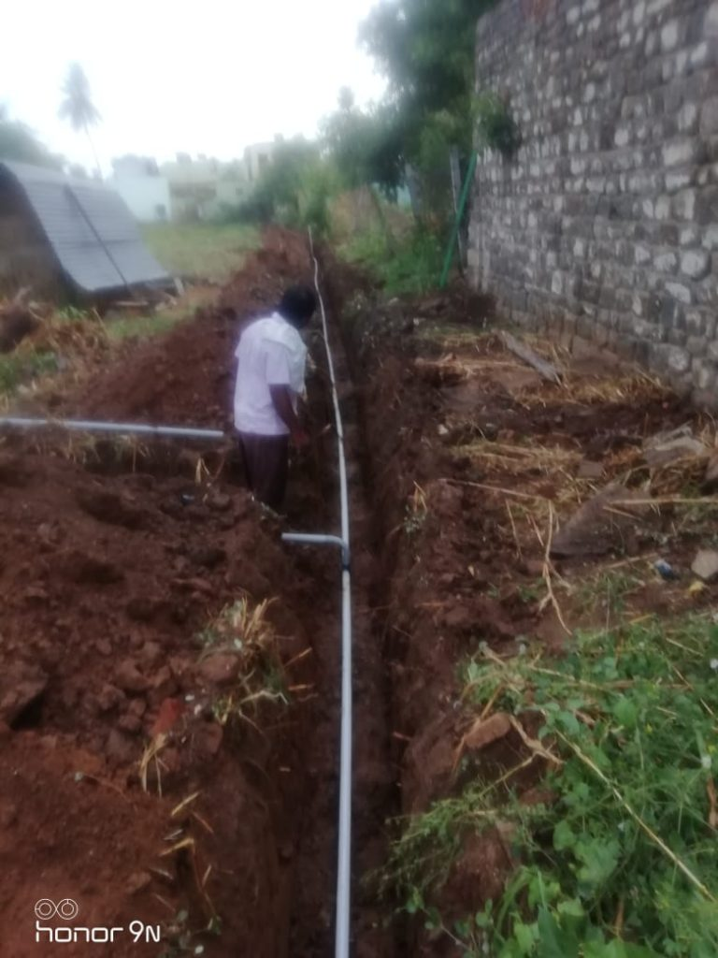
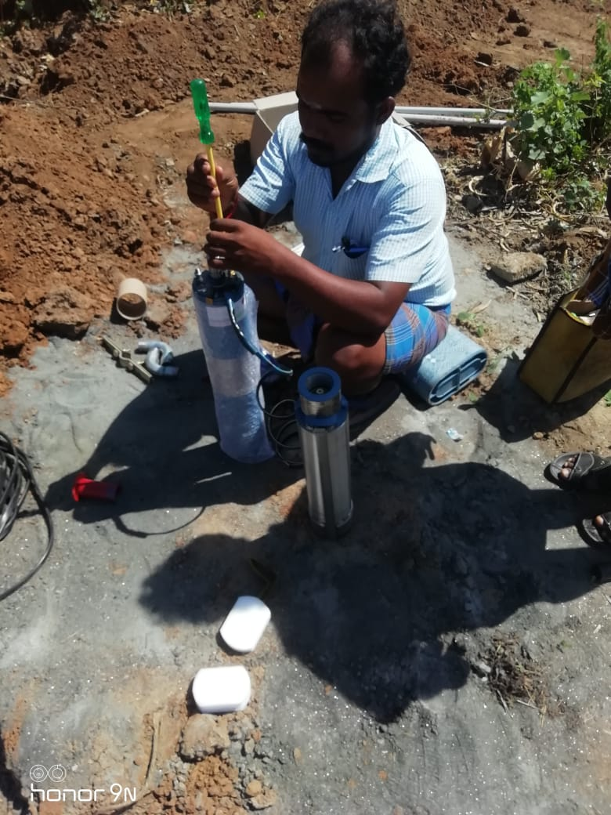
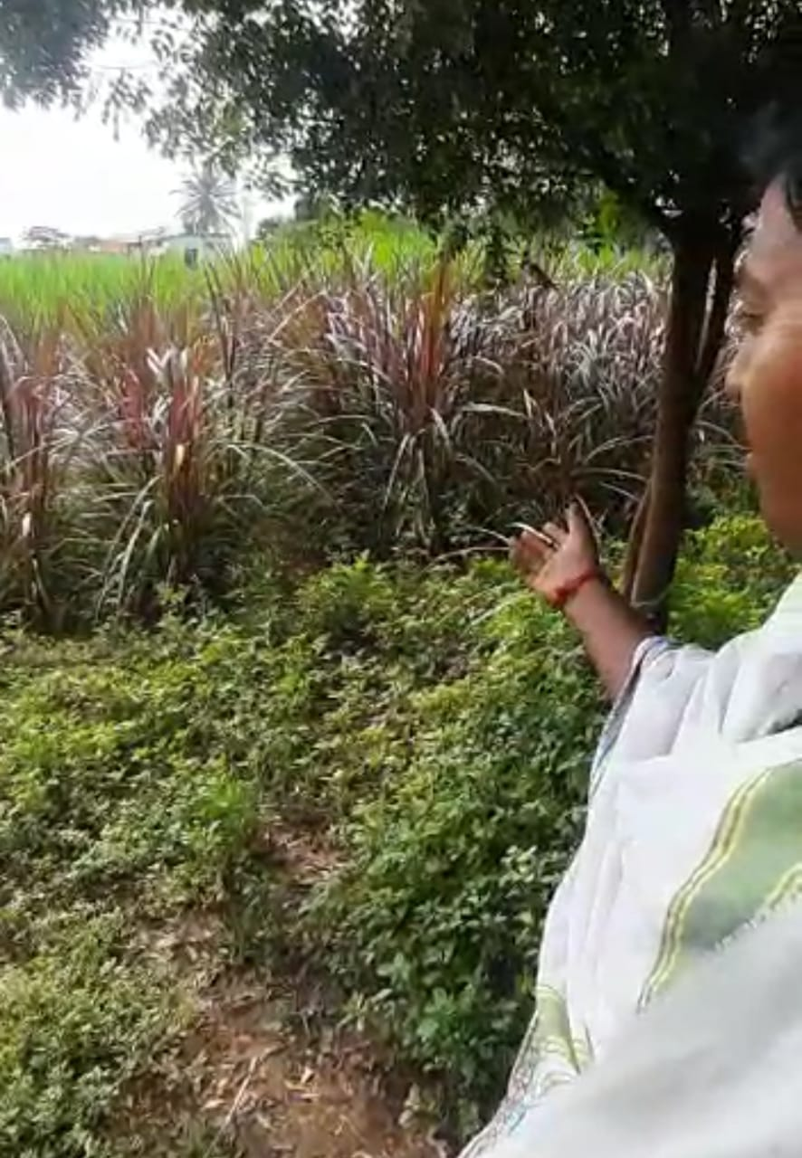
Goal 2: Farmer Partners (1 of 6)
Name: Dhanapal
Location: Kodumudi, Erode, Tamilnadu
Cows & Breads: 15 Kangayam cows
SAC Activities
Fodder Bank creation
Borewell Installation
Caretaker Honorarium (INR 54K P A)
Impact
Important water source for cows
Helps grow green fodder for cows
Specialized caretaker-driven cow maintenance

Slide 9
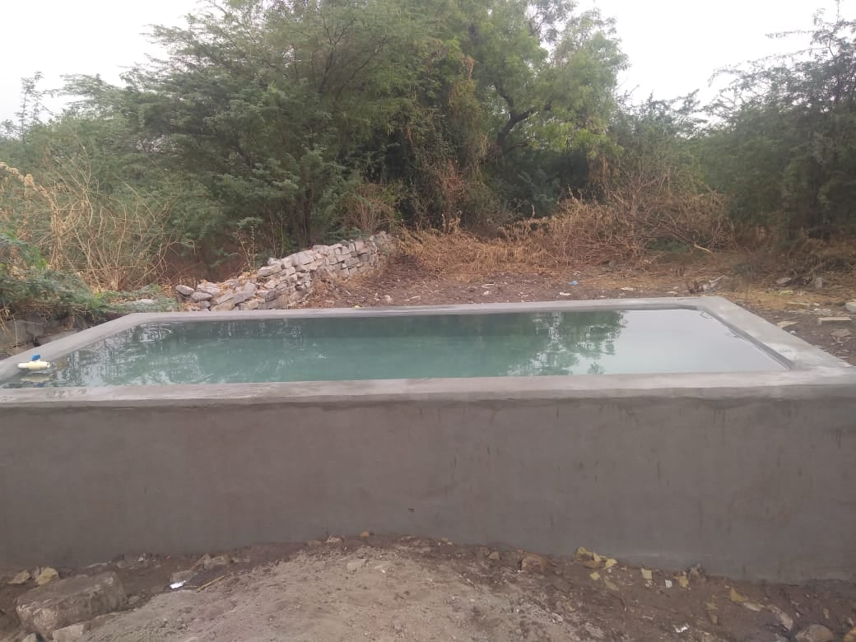
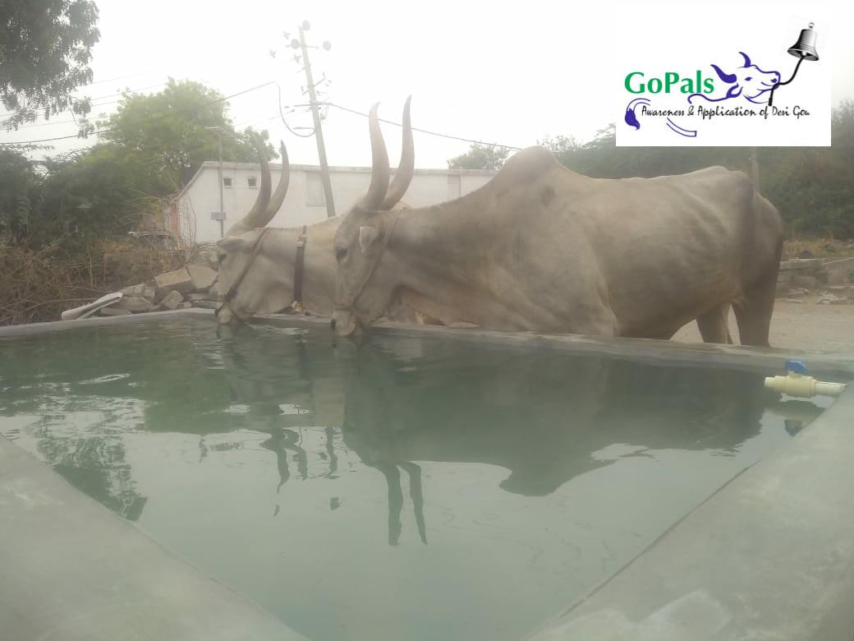
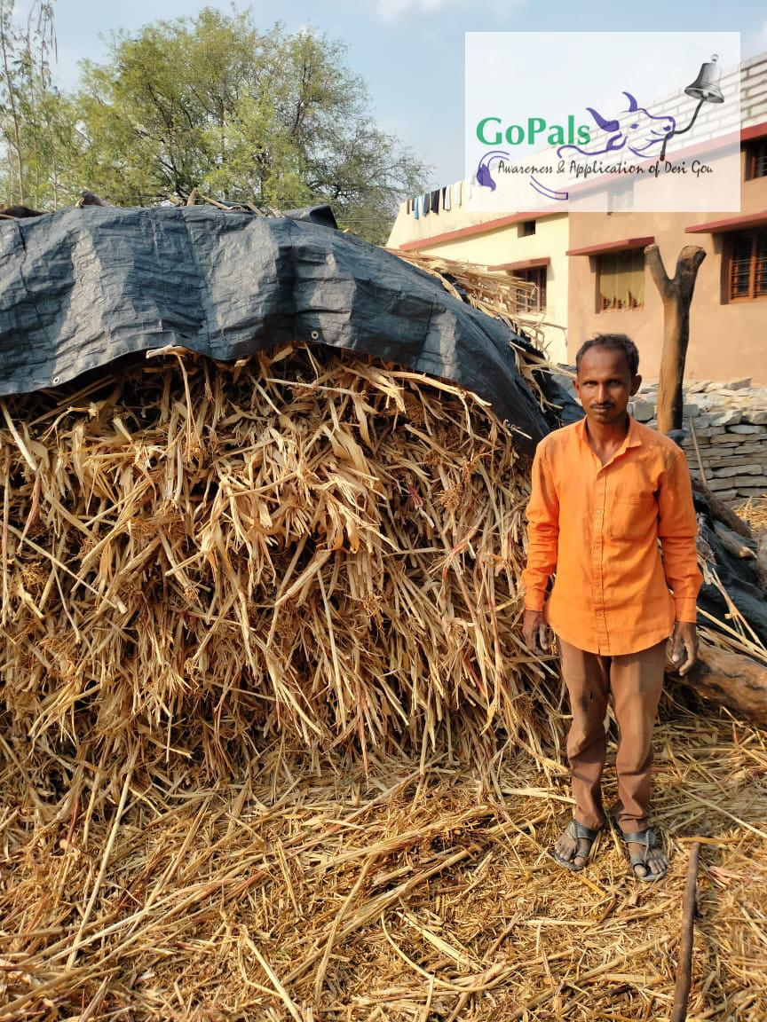
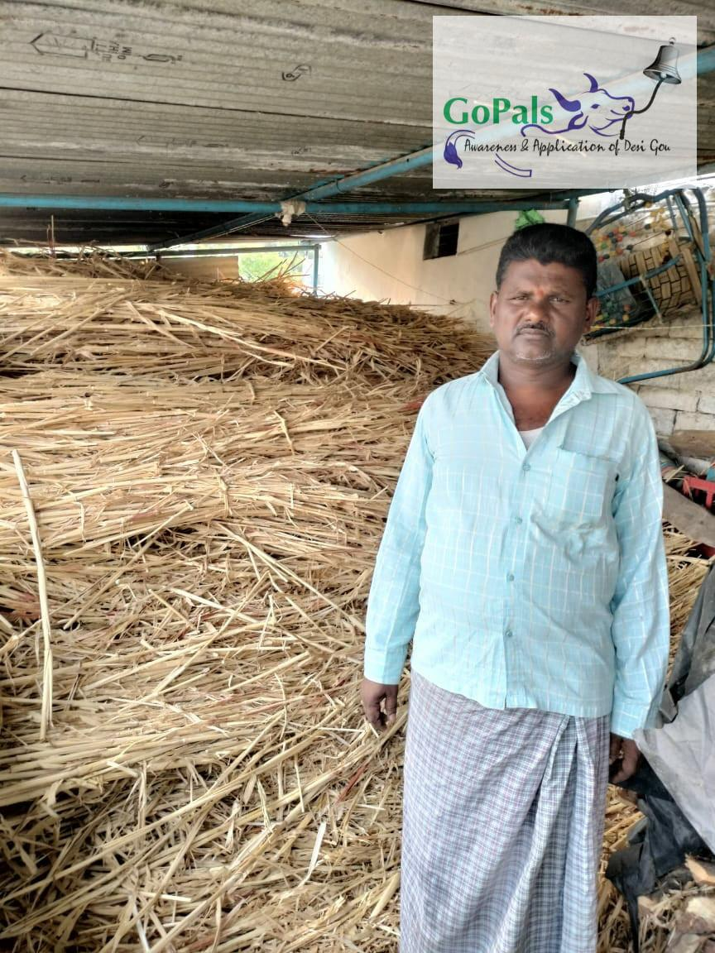
Goal 2: Farmer Partners (2 of 6)
Name: Shivalinga
Location: Batgera, Sedam, Karnataka
Cows & Breads: Village has 800+ Native cows & bulls. Primarily local breeds like Deoni, Khilari and Javari
SAC Activities
Fodder Bank creation
Water Tank development
Caretaker Honorarium (INR 54K P A)
Impact
Important water source for village cows
Dry fodder distributed to marginal farmers in summer
Specialized caretaker-driven cow maintenance

Slide 10
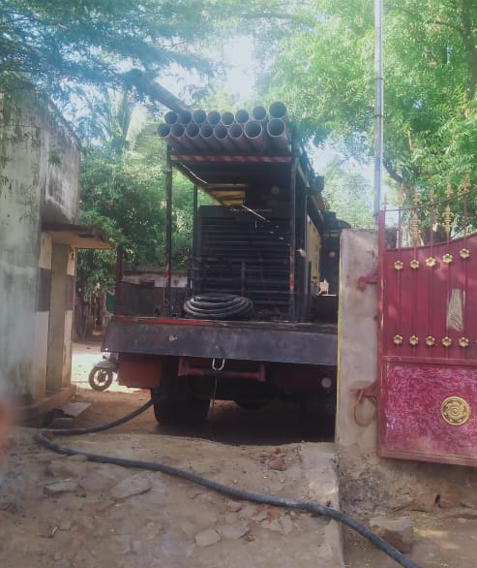
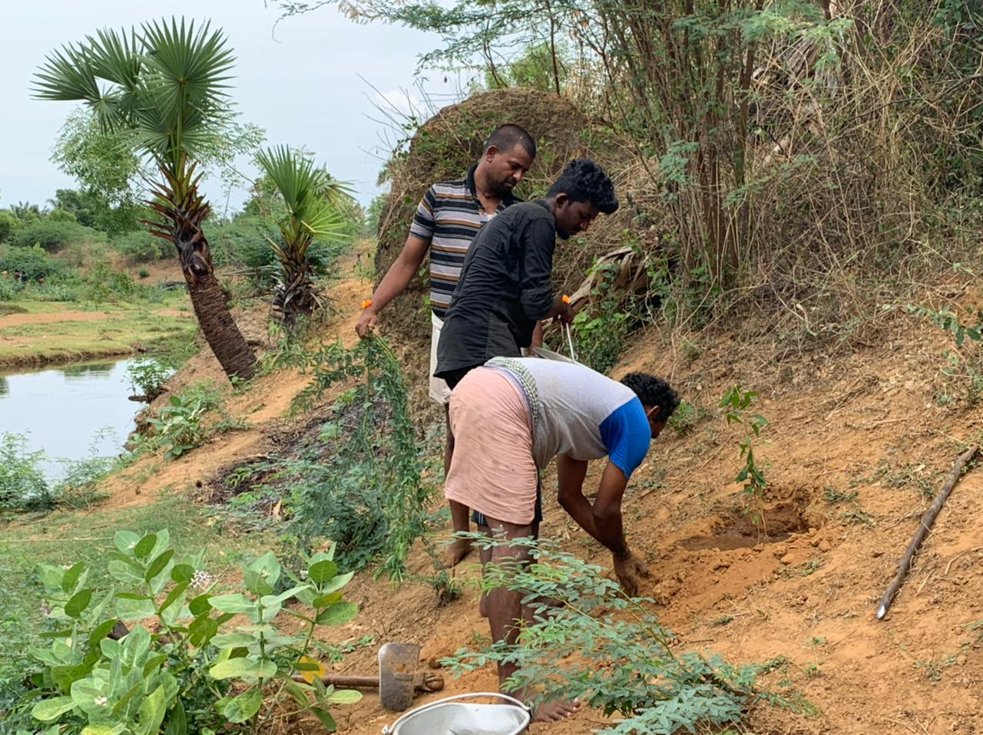
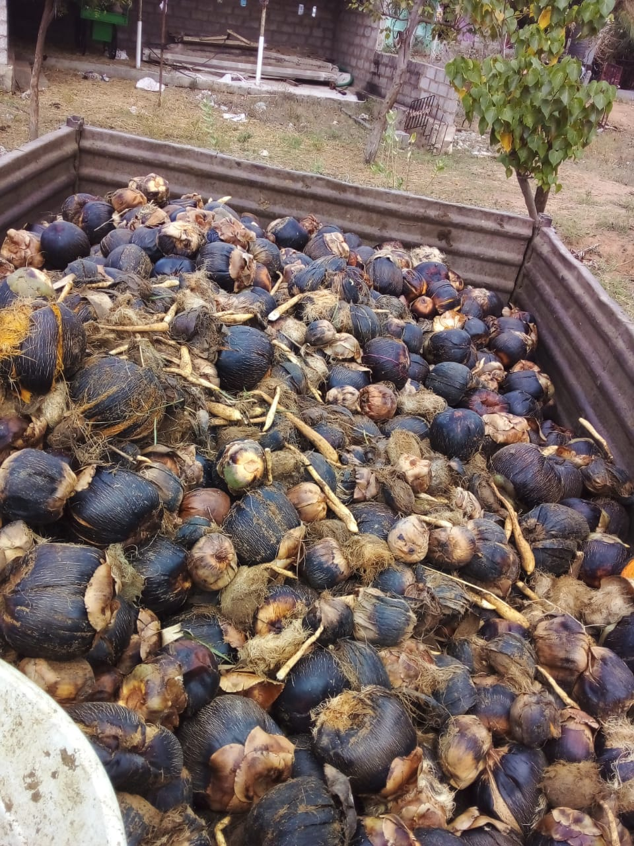
Goal 2: Farmer Partners (3 of 6)
Name: Cluster of 75+ natural farmers
Location: Tirunelveli, Tamil Nādu
Cows & Breads: 28 cows and bulls. Breeds include Chengalpattu, Kangeyam, Sahiwal and Nellaikuttai
SAC Activities
Fodder Bank creation
Borewell installation
Agroforestry (distributed of native seeds of Palm (5000 saplings), Tamarind and Coconut saplings)
Pradhan Mantri Suraksha Bhima Yojana (PMSBY) coverage for 75 farmer families
Worked for Government Press Release permitting farmers to do natural grazing in Western Ghats through Tamil Nadu
Caretaker Honorarium (INR 54K P A)
Impact
Important water and fodder source
Dry fodder distributed to marginal farmers in summer
Specialized caretaker-driven cow maintenance
Government Permission of forest grazing benefits 200,000 cows and bulls
Promotes Breed Development and Conservation (one of the Goals)

Slide 11
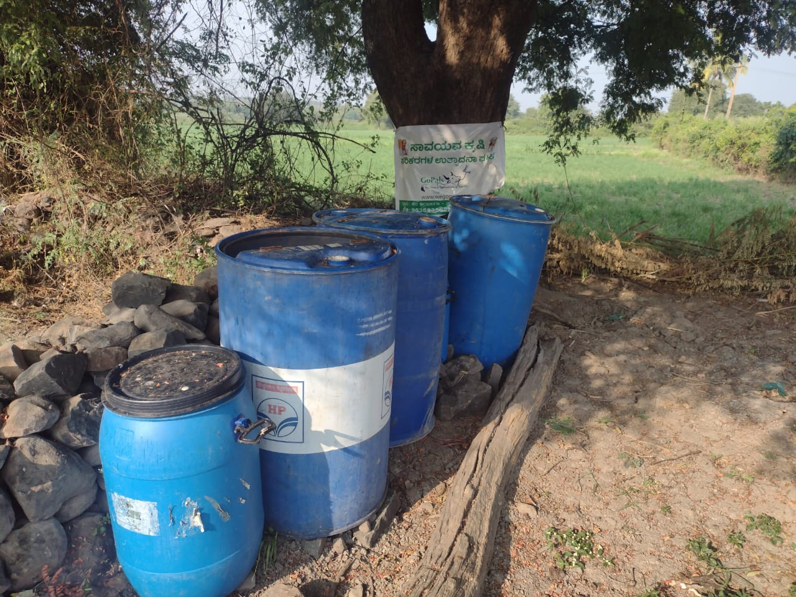
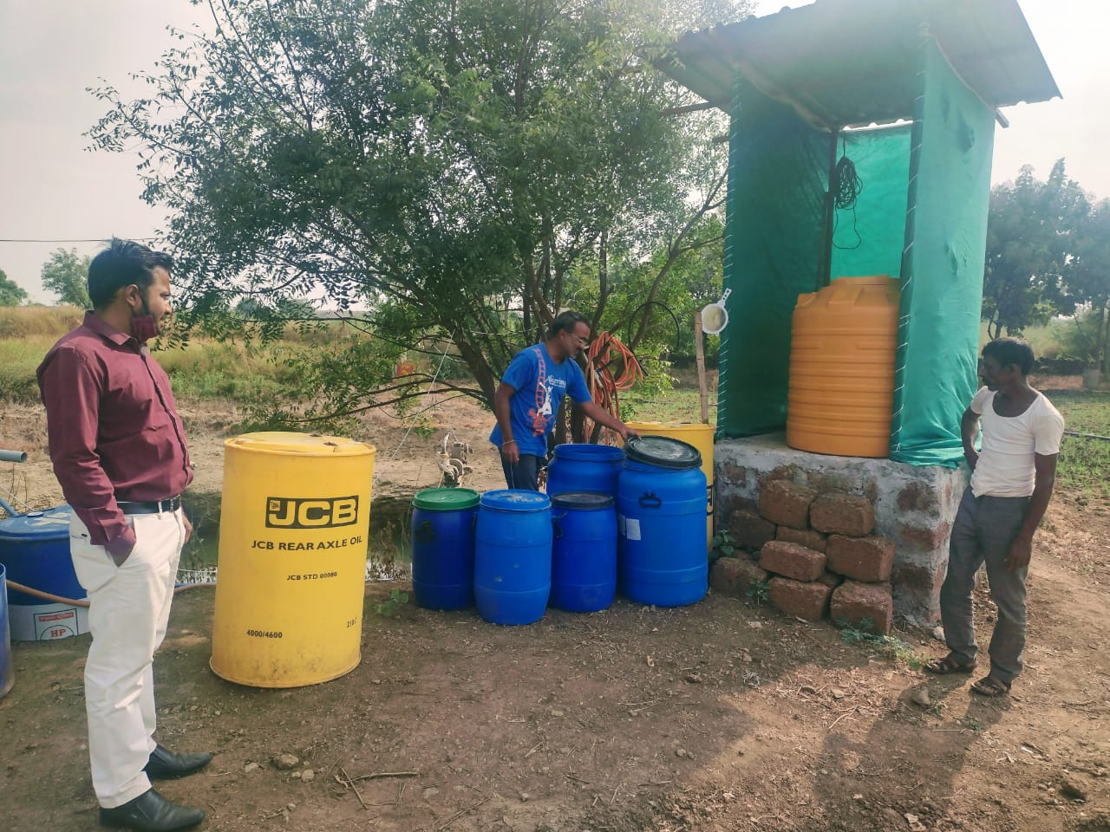
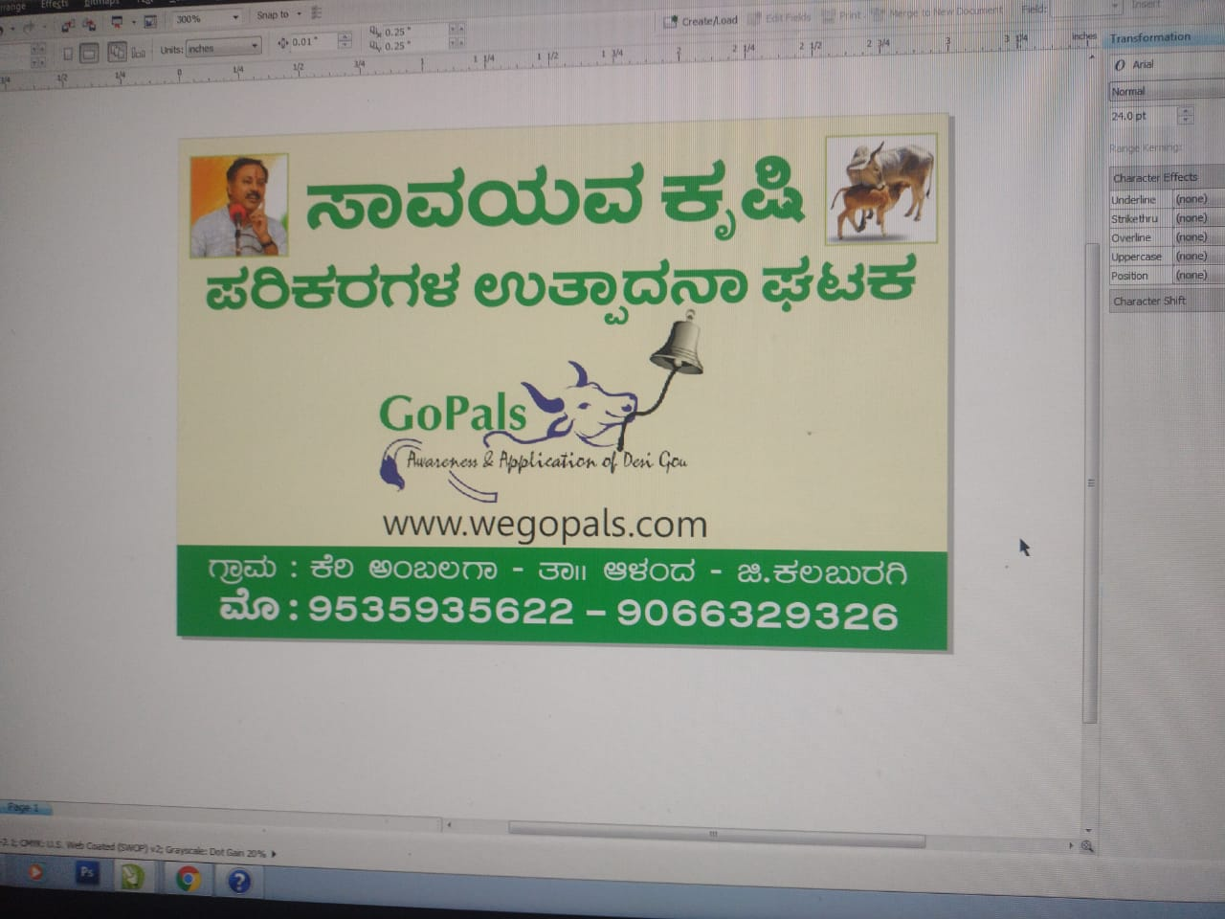
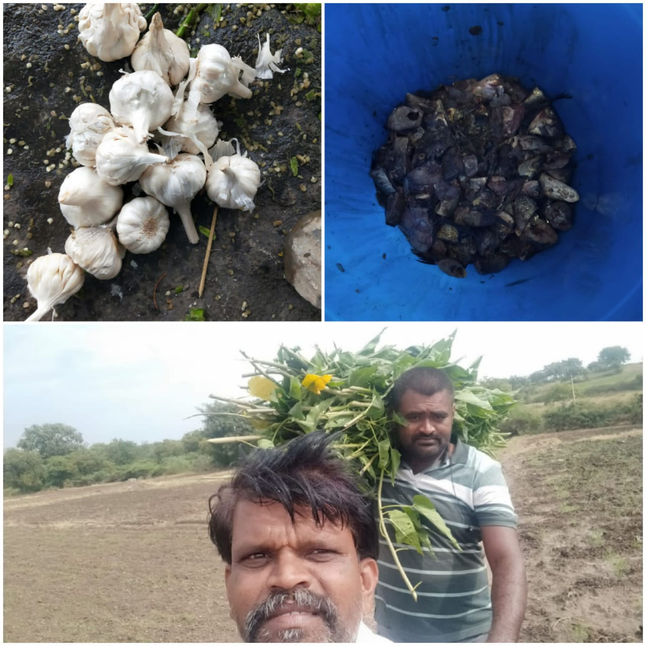
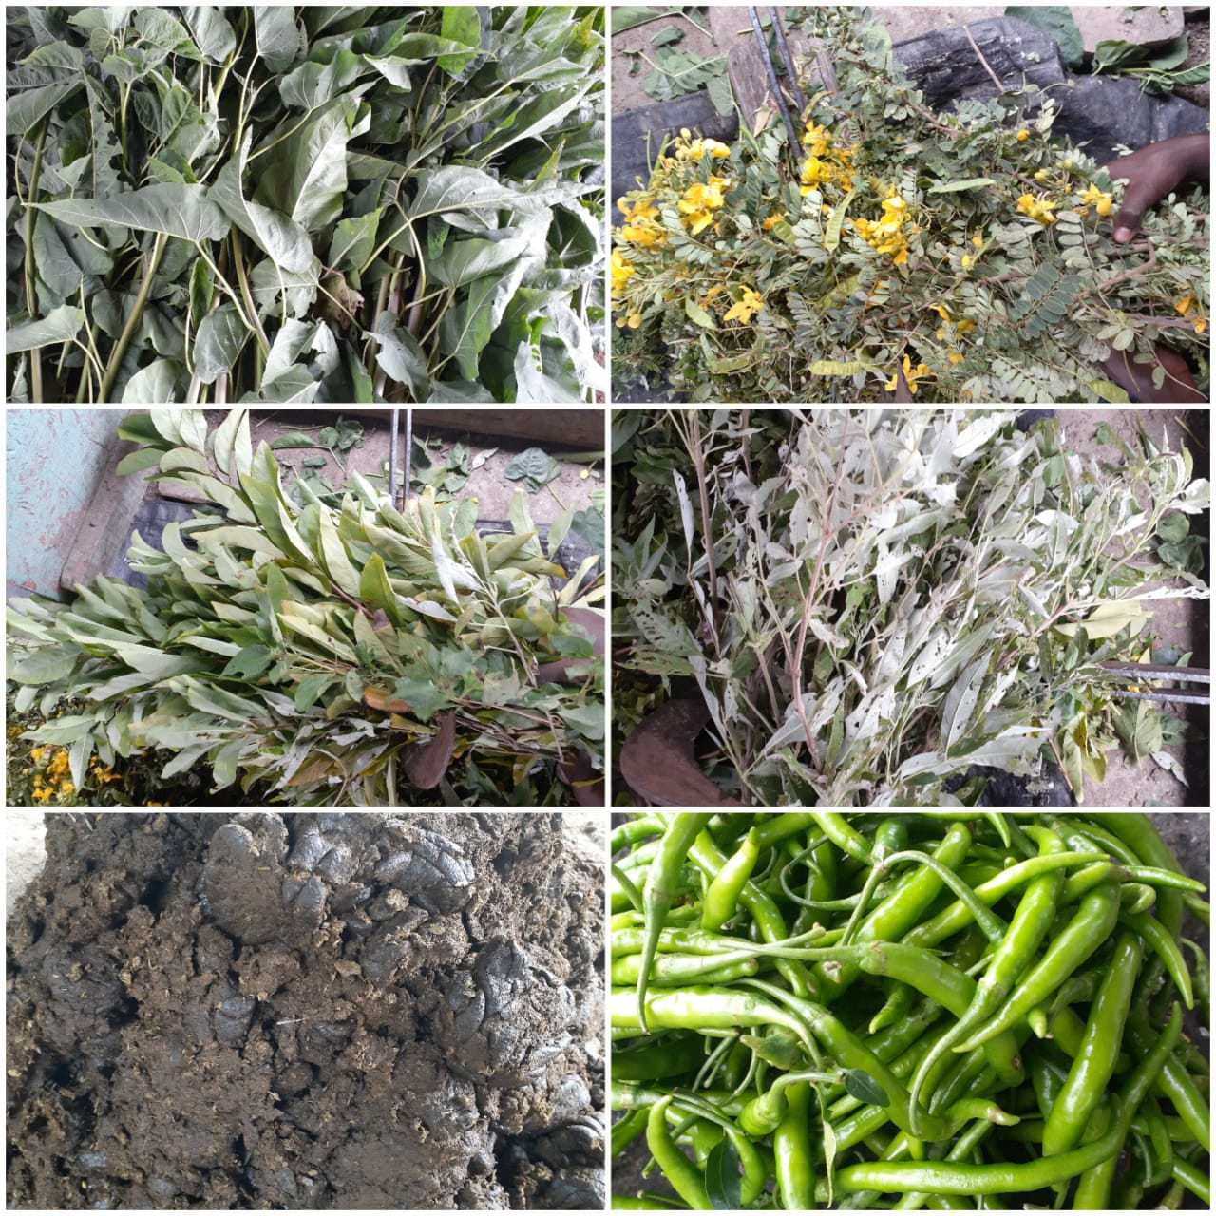
Goal 2: Farmer Partners (4 of 6)
Name: Prashant Biradar & Hanamanth Budivanth
Location: Keri Ambalga, Kalburgi, Karnataka
SAC Activities
Organic Input Centre setup
50K to purchase the raw materials and accessories with equal contribution from local farmers
Impact
Inspired by this village, two more villages have set up their own organic input center with their own contributions under the guidance from Team GoPals
Natural farming inputs at minimal cost compared to chemical inputs
Local cow breeds preserved and developed
Promotes entrepreneurship in village
Promotes natural farming adoption

Slide 12
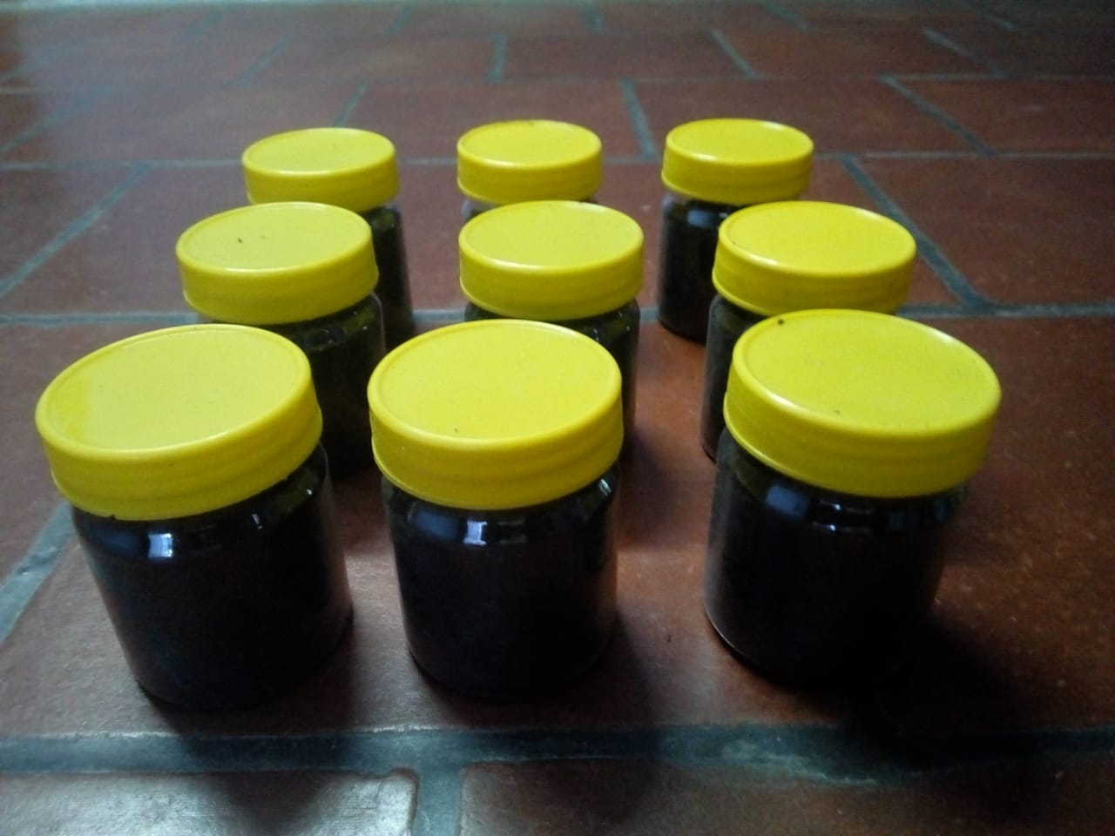
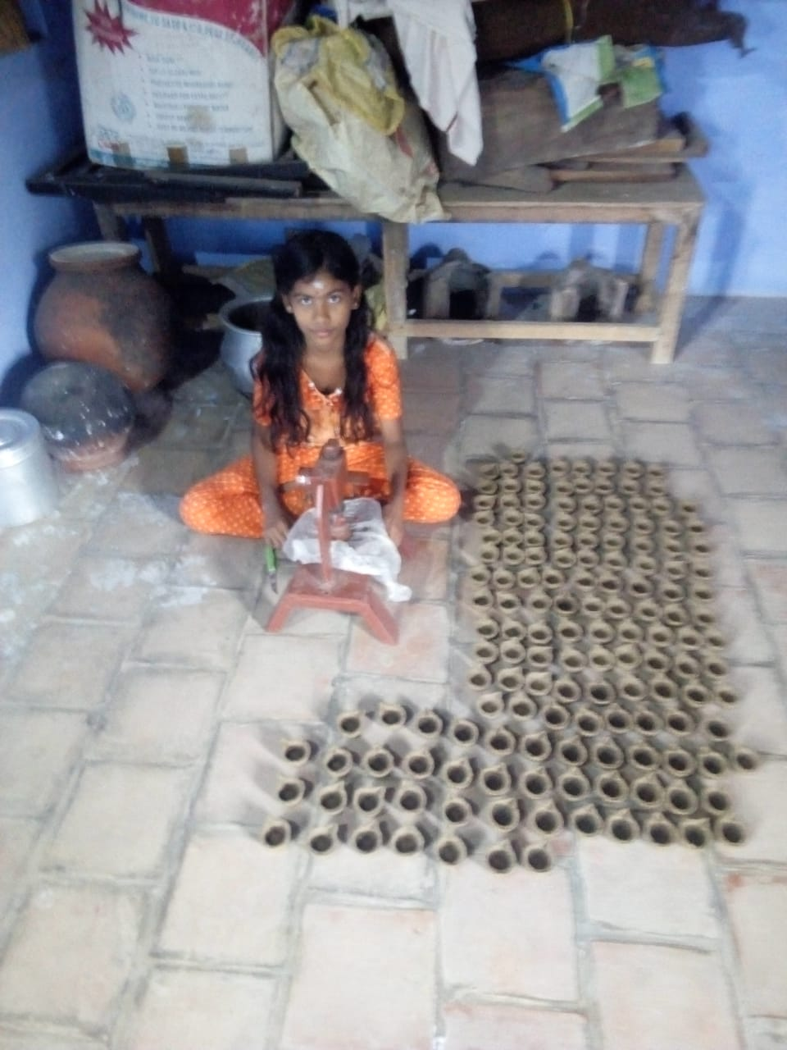
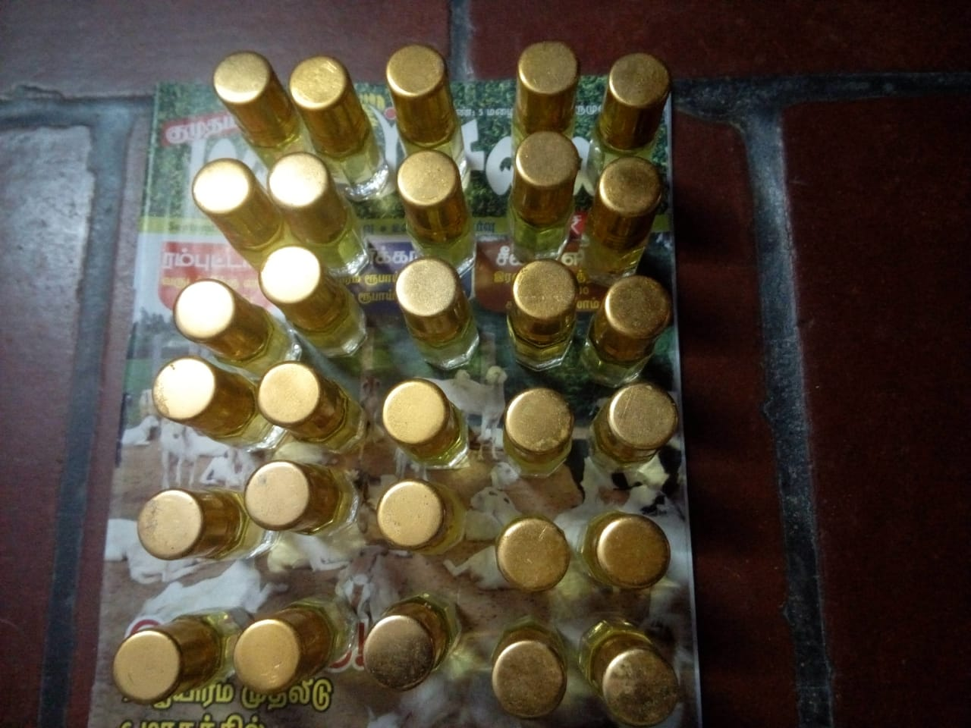
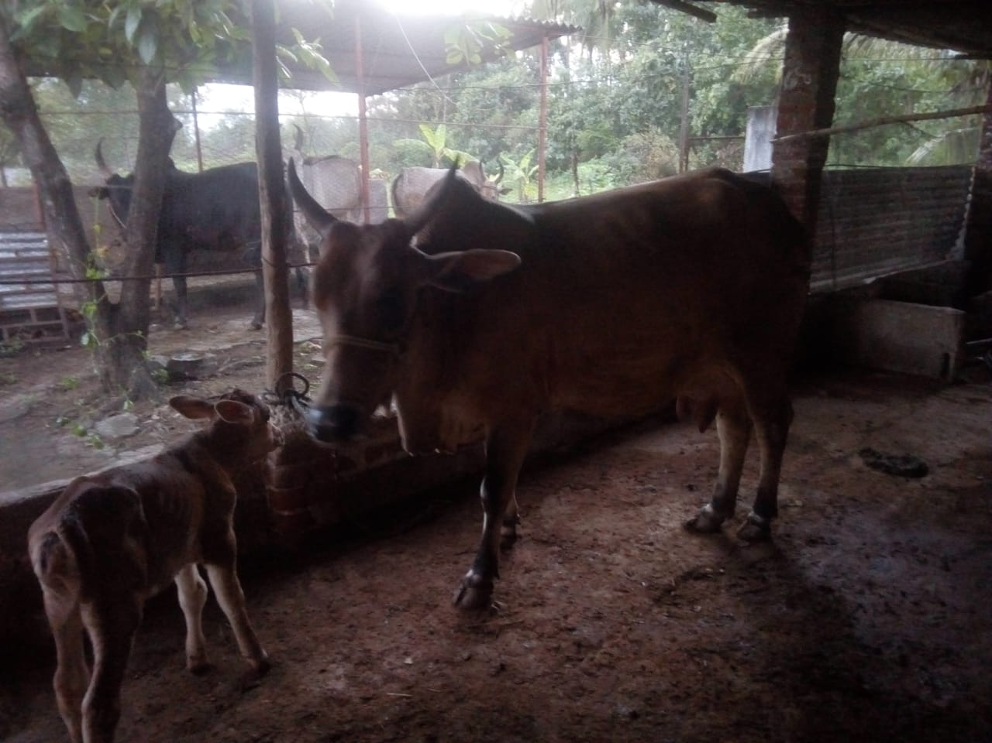
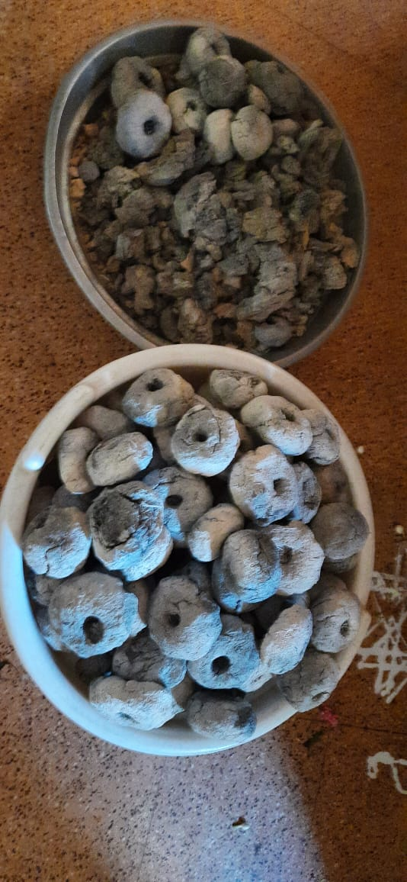
Goal 2: Farmer Partners (5 of 6)
Name: Periyasamy (natural farmer, rearing 4+ Kangeyam cows, Certified Panchagavya specialist)
Location: Alwarkuruchi, Tirunelveli, Tamil Nādu
SAC Activities
Supported for leasing the land for Gouadharith Krishi
Panchagavya products production unit setup
Impact
Manufactured Gomaya products like Tooth Powder, Vibhuti, Manure, Headache Balm, Shampoo, Floor Cleaner, Facial Pack, Gomaya Deepam
Cultivated chemical free vegetables and native variety rice
Promotes entrepreneurship

Slide 13
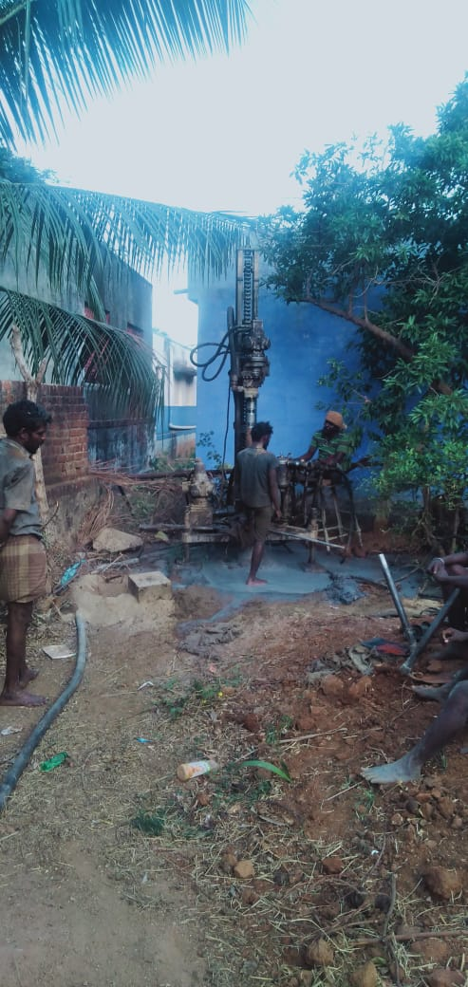
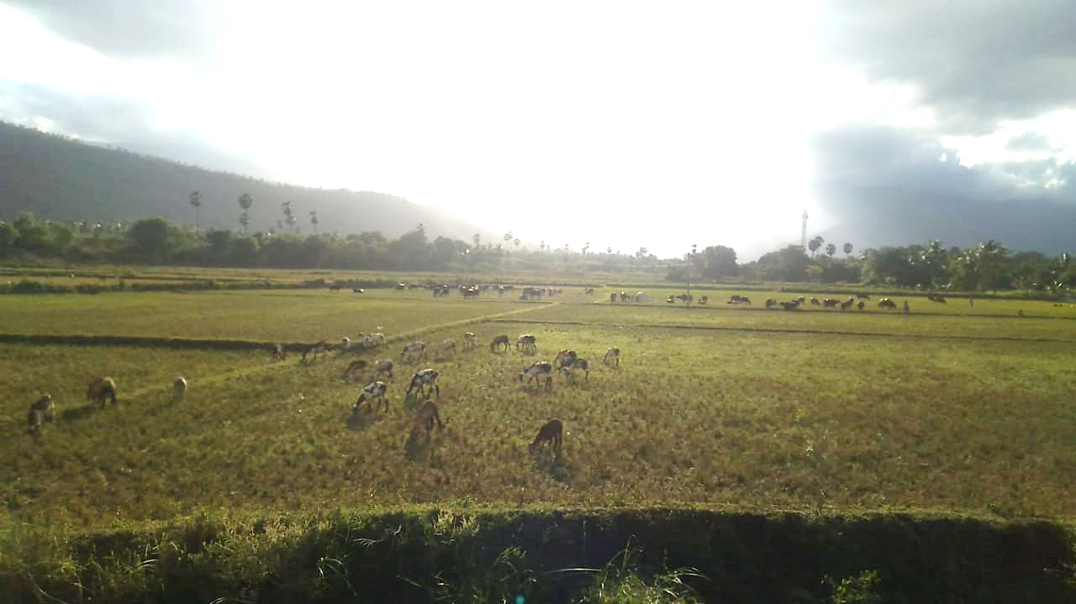
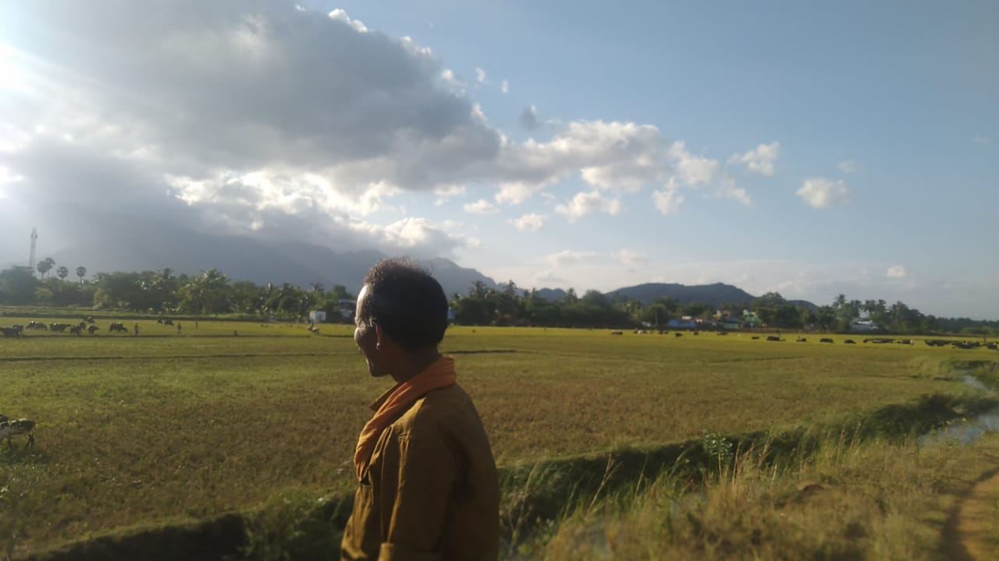
Goal 2: Farmer Partners (6 of 6)
Name: Muthu Kumar
Location: Ravanasamudram, Tirunelveli, Tamil Nadu
SAC Activities
Borewell Installation
Fencing around Goushala
He needs support for laying concrete for his Goushala
Impact
Water source for all the grazing cows in and around the village

Slide 14
Goal 3 - Sponsor a Calf (SAC) – Expand beneficiaries
Existing beneficiaries - Sustained
Organic Input Centres – Receiving enquiries for additional centres
Pradhan Mantri Suraksha Bhima Yojana (PMSBY)
Farmers making their own cow-based products benefiting agriculture in their area
We need ideas to expand further

Slide 15
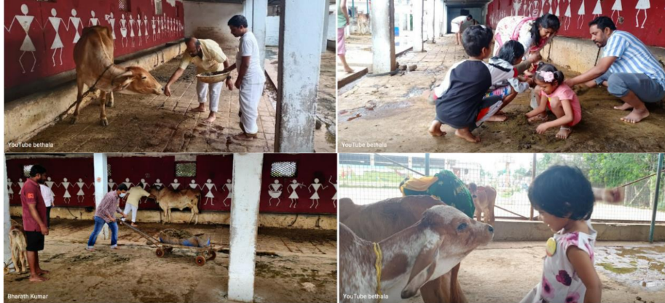
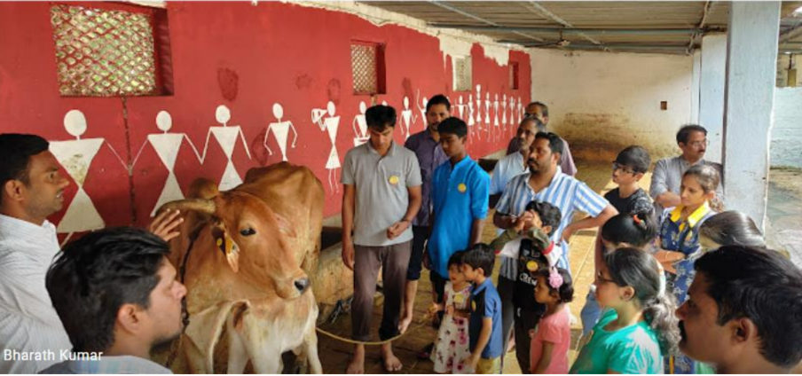
Goal 4 – Volunteer Base – Expand
Events Conducted
Nature for Cows – Gou Sankranthi - Bangalore, Karnataka
Ugadi With Cows – Bangalore, Karnataka
Lets Go Green – Hyderabad, Telangana
Increase social media presence

Slide 16
Goal 5 - Corporate Connect – Enhance connect with corporates
Events
Tree Plantation – Shivaganga
Sapling Plantation – Bangalore
Tree Plantation Drive – Chennai
Workshops
Employee Carbon Footprint

Slide 17
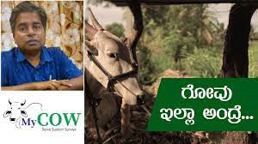
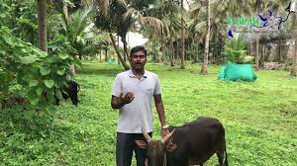
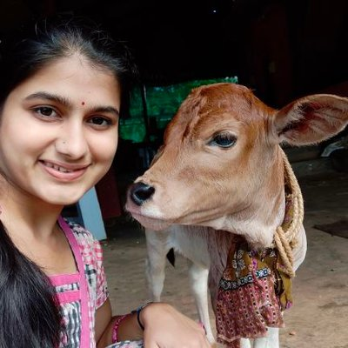
Goal 6 – Know Your Cow
MyCow Campaign Conducted during August 2022 to December 2022
Eminent personalities asked to express opinion on:
Importance of Native Cow
Their Contribution to cause of Native Cow
Vision & Message to Youth - Atmanirbhar Bharath / Sustainable Bharath

Slide 18
Goal 7 & 8 – Sustain a Farmer (SAF). Farmer to Consumer (F2C)
Pradhan Mantri Suraksha Bhima Yojana (PMSBY) coverage for 75 farmer families in Tirunelveli, Tamil Nādu
Encourage concept of Family Farmer (Farmer to Consumer) – Connect urban consumers to natural farmers and facilitate mutually beneficial interactions

Slide 19
Goals - 2023
Organic Input Centers – Expand
Farmer Partners – Evaluate requirements and extend support – existing / new
Sponsor a Calf (SAC) – Expand beneficiaries
Volunteer base – Expand
Corporate Connect – Enhance connect with corporates
Know Your Cow (KYC)
Sustain a Farmer (SAF) – Expand Pradhan Mantri Suraksha Bhima Yojana (PMSBY) to other villages
Farmer to Consumer (F2C) – Explore options for online marketing
Bread Development and Conservation
Farmer Connect – Connect with more farmers and villages

